Slide 1
QHPC EX 2
By: Ryan Silverberg

Slide 2
Interconnection Networks

Slide 3
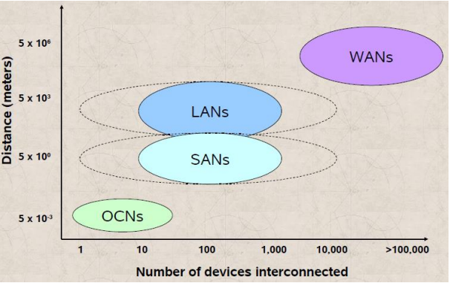
What domains do we care about?

Slide 4
Terminology
Links: Communication channels that carry signals
Switches: Connect input/output
Route: Sequences of links a message follows
Network: Modeled with a graph
Topology: Physical interconnect structure of network

Slide 5
Terminology
Topology – What
Routing Algorithm – Which
Switching Strategy – How
Flow Control – When

Slide 6
Two most important things
Latency
Bandwidth

Slide 7
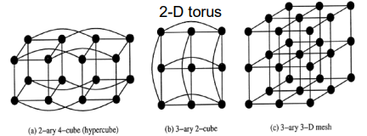
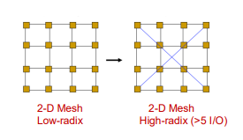
Direct Network Topologies
Orthogonal Topologies, has at least one link crossing each dimension

Slide 8
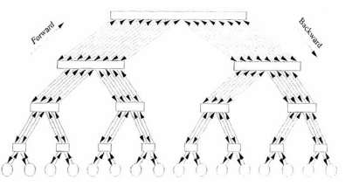
Fat Tree

Slide 9
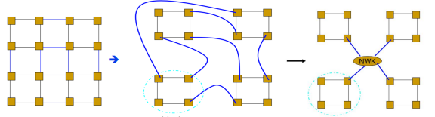
Dragonfly Networks
Routers, Groups, Systems, Indirect Network

Slide 10
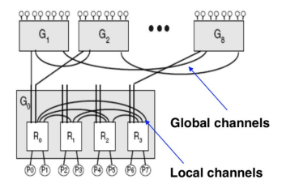
Dragonfly Networks

Slide 11
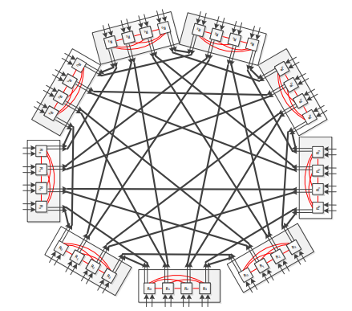
Dragonfly Networks
4,2,2

Slide 12
How do we connect?

Slide 13
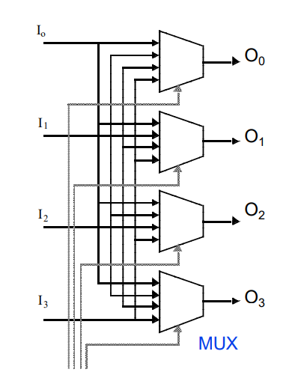
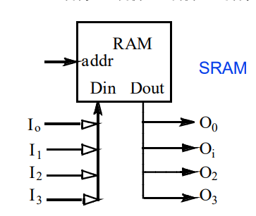
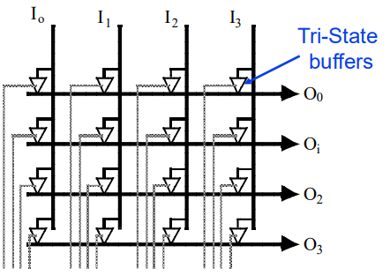
Crossbar

Slide 14
Crossbar
N inputs
M outputs
Cost is O(NM)

Slide 15
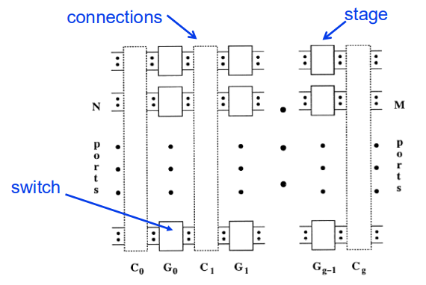
MIN Networks
N inputs
M outputs
G stages

Slide 16
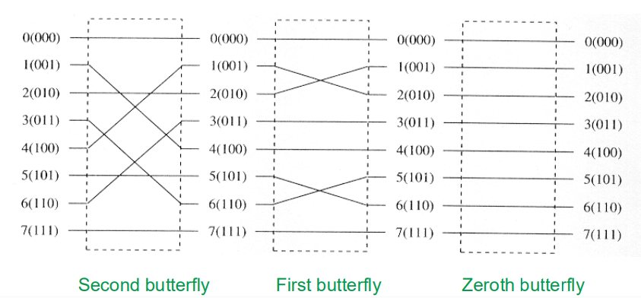
Butterfly Permutation
Interchanges the zeroth and ith digits of index

Slide 17
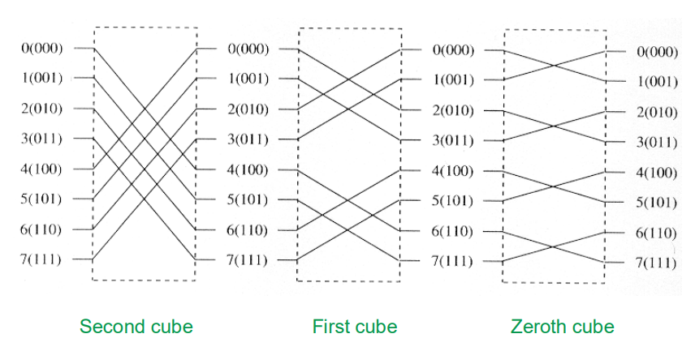
Cube Permutation
Complements the ith bits of the index

Slide 18
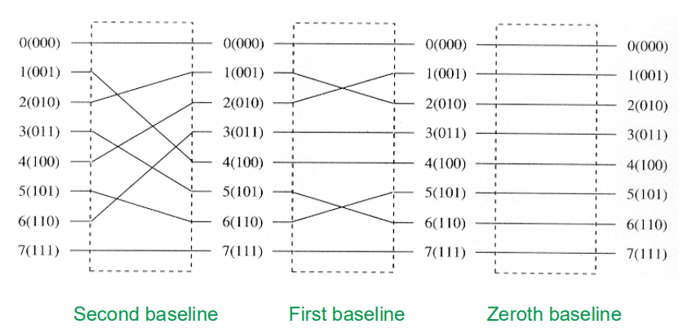
Baseline Permutation
Performs a cyclic shift of the i+1 least sig digits in the index to the right for one position

Slide 19
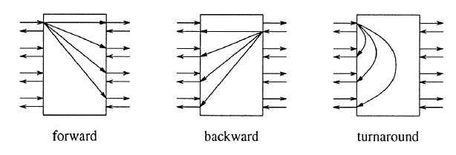
BMIN

Slide 20
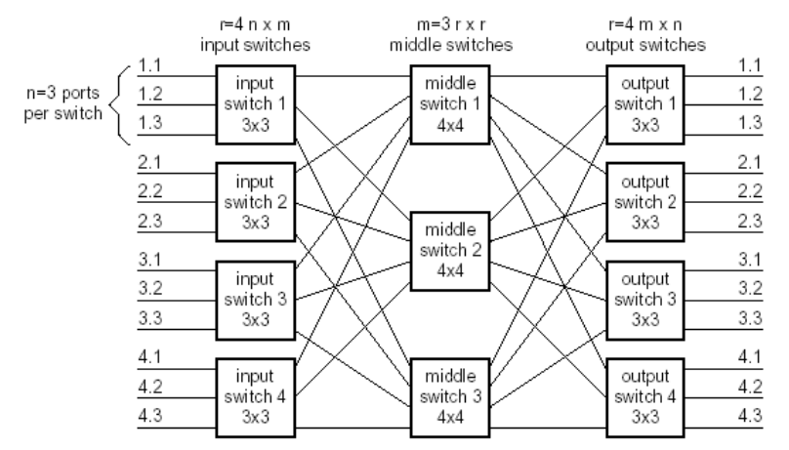
Clos Networks

Slide 21
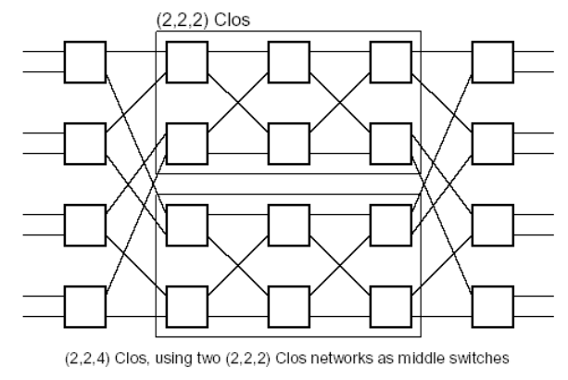
Benes Networks

Slide 22
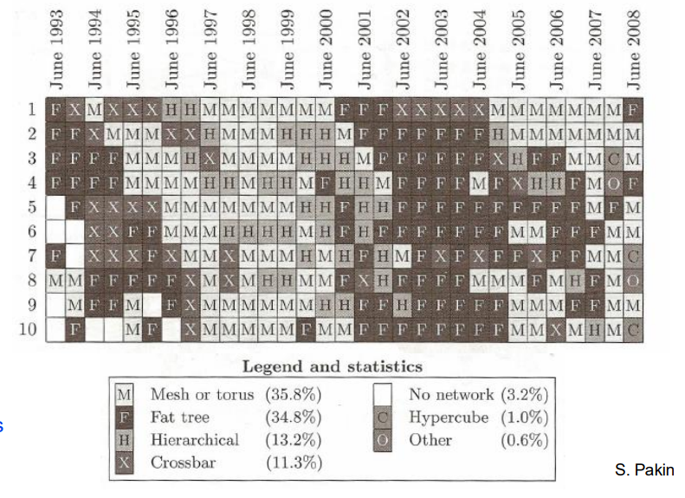
History

Slide 23
Homework
I can either post my textbook or google it
Understand what packet switching vs circuit switching is
Beginning of ELEC 373 Computer Networks

